Slide 1
JPEG XR:
Double Compression Detection
Daniel Kocher, Michael Harasek

Slide 2
Overview
Introduction
  Project description
  Functioning of JPEG XR
  Theory of double compression detection
Implementation
  Reading out the coefficients
  Generating the histograms
  Interpret and quantify the histogram data
Result

Slide 3
Introduction
Implementation
Result

Slide 4
Project description
Goal:
  Finding a method to detect double compressed JPEG XR pictures
  Developing a toolset that analyses pictures due to detect double compression
Reason:
  Usual way to manipulate a picture is with an edit-software like Photoshop
  → Load and resave (compressing second time)
  Detecting double compression allows detecting picture manipulation
Introduction
Implementation
Result

Slide 5
Project description
First steps – Theory base:
  Functioning of JPEG XR
    Media Data Formats VO, University of Salzburg, Prof. Andreas Uhl
    Reference Implementation
  How is double compression detection done for JPEG / JPEG 2000
    Detecting Double Compressed JPEG Images (Institute of Information Theory and Automation of the ASCR - Czech Republic, Babak Mahdian and Stanislav Saic)
    Detection of Double Compression in JPEG2000 Images (Tianjin University (China), Jing Zhang, Haiying Wang, Yuting Su)
    …
Introduction
Implementation
Result

Slide 6
Functioning of JPEG XR
Short History:
  Originally developed by Microsoft
  2006 fist time presented as Windows Media Photo
  2007 published and renamed in HD Photo
  2009 standardized as ISO/IEC 29199-2 with the name JPEG XR
  2013 Microsoft published an open source library
Introduction
Implementation
Result

Slide 7
Functioning of JPEG XR
Key Facts:
  Data-Ending: .jxr (earlier .hdp and .wpd)
  Container: TIFF-similar
  Compression: lossy and lossless compression supported
  Classic 3-stage design: transform → quantisation → entropy encoding
Introduction
Implementation
Result

Slide 8
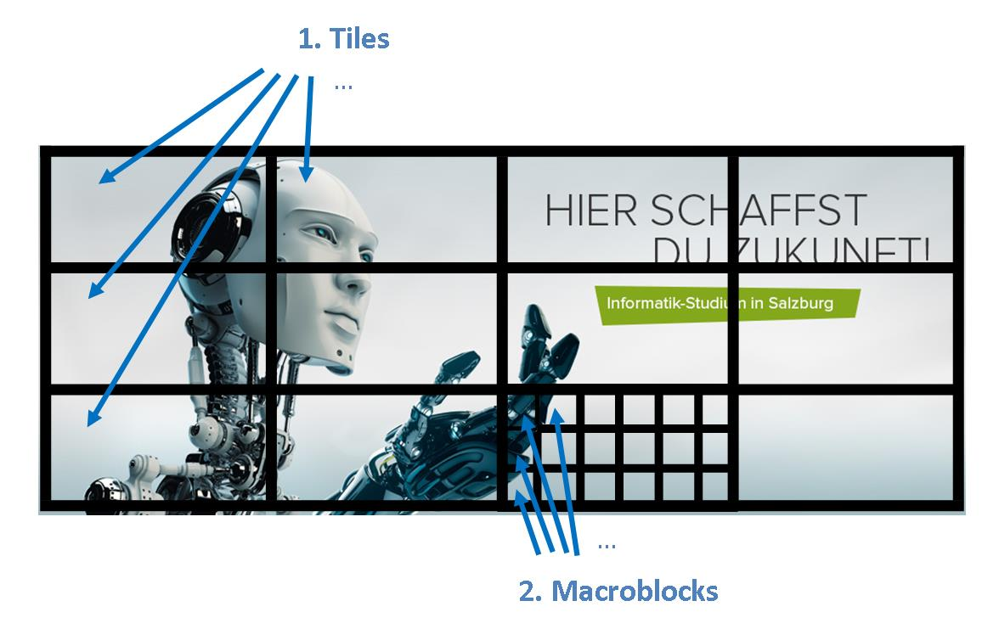
Functioning of JPEG XR
Structure:
  Tiles:
  Partitioning for larger pictures
  (smaller ones may only have one tile)
  Localized by (x|y) e.g. first is (0|0)
  Enables decoding of regions instead of
  the whole picture.
  Macroblock:
  A tile contains an array of macroblocks.
Introduction
Implementation
Result

Slide 9
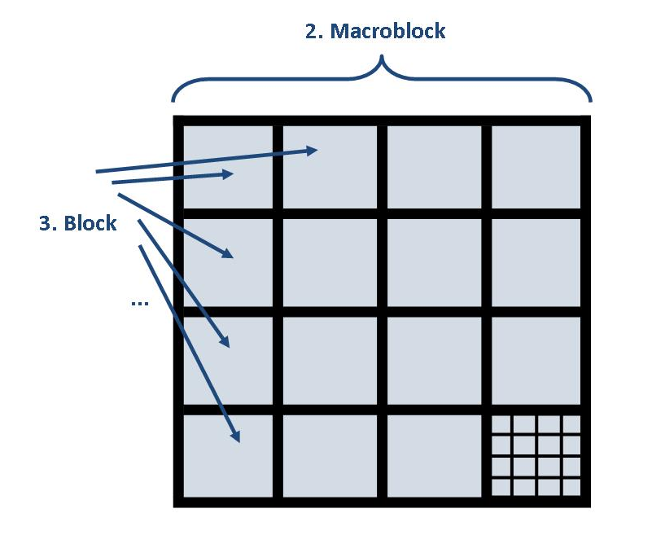
Functioning of JPEG XR
Structure:
  Macroblock:
  Each Macroblock consists of 4x4 = 16 Blocks
  Block:
  A block accommodates 4x4 = 16 Pixels
Introduction
Implementation
Result

Slide 10
Functioning of JPEG XR
Transformation:
  Inspired by discrete cosinus transformation (DCT)
  Integer-based transform allowing lossless reconstruction
  Applied to macroblock
  First stage: applied to all 4x4 blocks of a macroblock
  → 256 coefficients
  → 240 high pass coefficients
  → 16 coefficients representing the lower frequencies
Introduction
Implementation
Result

Slide 11
Functioning of JPEG XR
Transformation:
  16 low frequency coefficients organized in 4x4 square layout
  Transform applied again on this 4x4 square layout
  → 15 low pass (LP) coefficients
  → 1 DC coefficient
  Three scalability layers: DC, LP and HP
Introduction
Implementation
Result

Slide 12
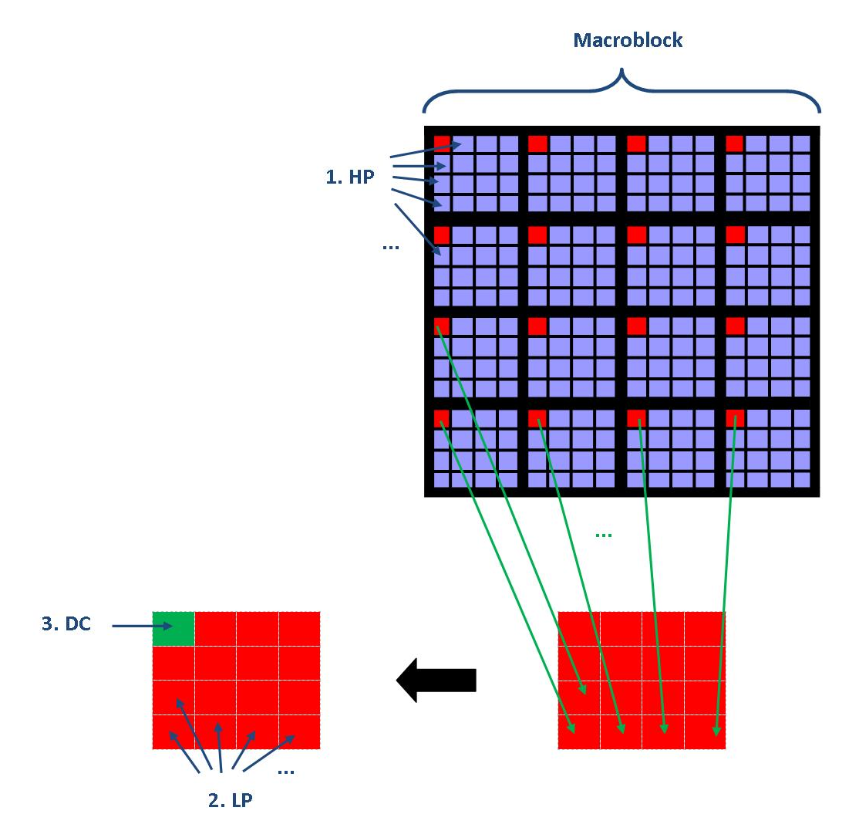
Functioning of JPEG XR
Coefficients:
  High Pass Coefficients (HP):
  15 HP / Block → 240 HP / Macroblock
  Low Pass Coefficients (LP):
  1 LP / Block (except first Block of Macroblock)
  → 15 LP / Macroblock
  Direct Current Coefficient (DC):
  “LP” of first Block in Macroblock
Introduction
Implementation
Result

Slide 13
Research
Already lots of research done for JPEG and JPEG 2000
Double quantization (DQ) effect is well studied
→ baseline of our approach
Trying the proposed approaches for JPEG XR
Introduction
Implementation
Result

Slide 14
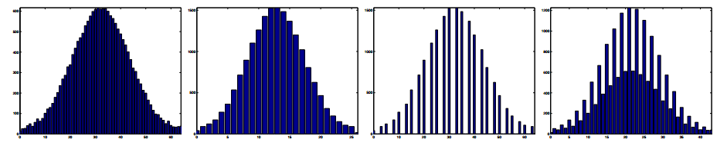
Theory of double compression detection
DQ effect in JPEG images:
  Intuitively: the exhibition of periodic peaks & valleys in the histogram
  Given two compression qualities q1 and q2:
  → the bigger q1/q2 is, the better the DQ effect is visible
  E.g. for single and double compressed JPEG images (J. He et al. [1]):
Introduction
Implementation
Result

Slide 15
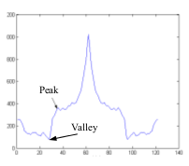
Theory of double compression detection
DQ effect in JPEG 2000 images:
  Most high frequency sub-bands quantized to zeros
  No periodic artifacts are produced but more abrupt slopes
  FFT → range between peak and valley is obtained
  J. Zhang et al. [2]:
Introduction
Implementation
Result

Slide 16
Theory of double compression detection
Implications:
  Periodic pattern in histogram indicate double compression
  → zeros and double peaks
  Patterns depend on the quality parameters
  → reconstruction of compression qualities
  Only low frequency coefficients are of relevance
  Ratio and order of quality factors matter
Introduction
Implementation
Result

Slide 17
Theory of double compression detection
Necessary steps (simple):
  Read out the coefficients of an image
  Generate corresponding histogram data
  Generate and find differences in histograms of single and double compressed images
  Find a way to quantify the histogram data so that the differences can be shown by a number
  Find a value to make a statement about whether a given JPEG XR file has been double compressed or not
Introduction
Implementation
Result

Slide 18
Theory of double compression detection
Double compressing JPEG 2000 images:
  Let Q1 and Q2 denote two different quantization matrices
    First compression: Coefficients are quantized using Q1
    → values are multiples of Q1[i][j]
    Decompression: Pixels are integer rounded in interval [0, 255]
    → values are spread around multiples
    Second compression: Coefficients computed from rounded values
Introduction
Implementation
Result

Slide 19
Introduction
Implementation
Result

Slide 20
Reading out the coefficients
Two libraries:
  Reference implementation (T.835)
  Microsoft implementation
Two possibilities:
  At the decompression of the picture (loading the picture)
  At the compression of a picture (saving the picture)
Introduction
Implementation
Result

Slide 21
Reading out the coefficients
Our choice:
  Reference implementation (T.835),
  because of better comments
  At the decompression of the picture (loading the picture),
  because the source picture can already be JPEG XR
Introduction
Implementation
Result

Slide 22
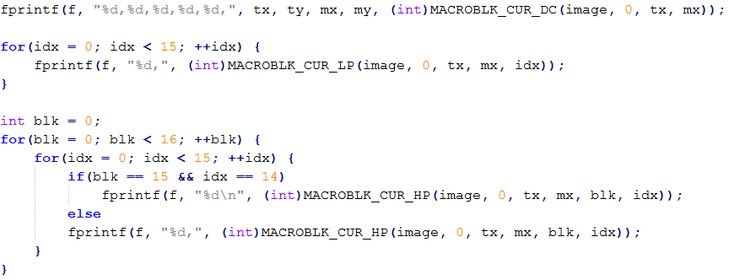
Reading out the coefficients
Our implementation:
  Modification of the library’s decompression routine (r_parse.c)
  At reading a macroblock the coefficients get written out to a comma separated file (csv)
  Code-Example:
Introduction
Implementation
Result

Slide 23
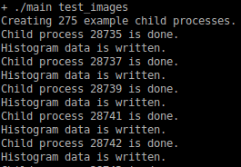
Generating the histograms
The main program:
  Calls for each available test picture the library and reads out the coefficients (as described before), so for each picture a csv file with all coefficients exists
  Generate for each coefficient file the histogram data files
Introduction
Implementation
Result

Slide 24
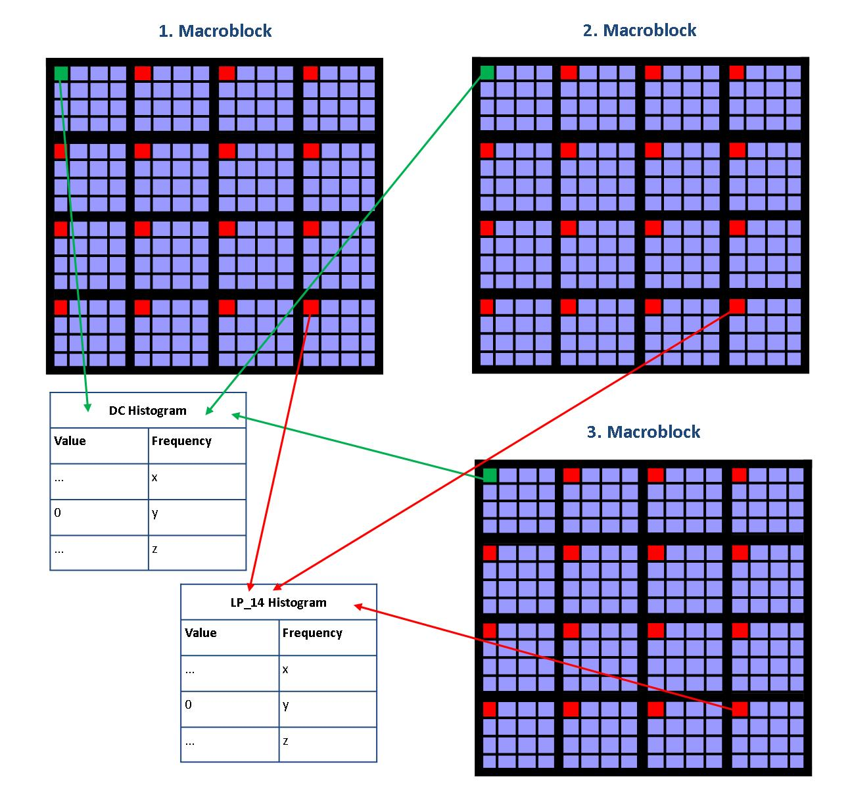
Generating the histograms
Generate the histogram data:
  Created for each (interesting) coefficient
  Takes each occurring value and counts its
  frequency
  ‘HP’ seem to be not of interest (many zeros),
  so we got 16 interesting histogram data files
  per picture:
    1x DC (hist0.dat)
    15x LP (hist1.dat - hist15.dat)
Introduction
Implementation
Result

Slide 25
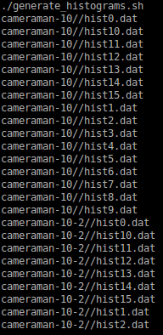
Generating the histograms
Generate the histograms:
  A shellscript calls for each histogram data file
  gnuplot to generate the histogram
Introduction
Implementation
Result

Slide 26
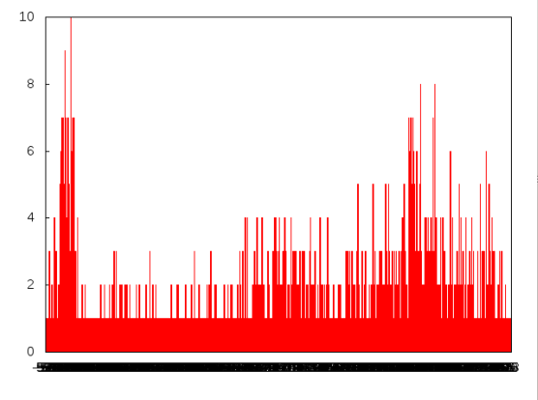
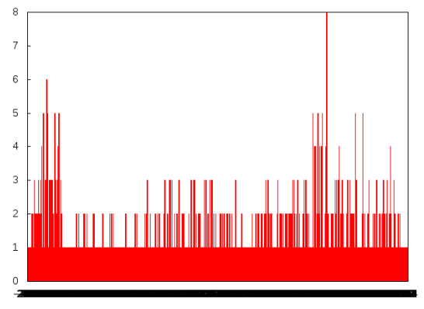
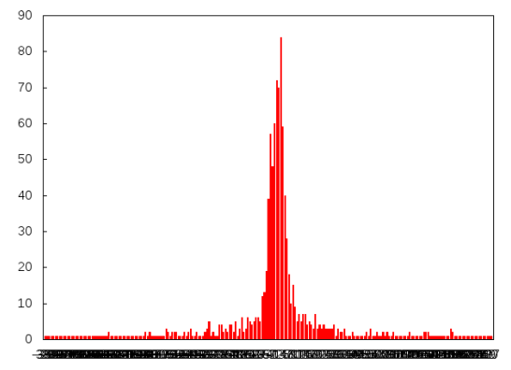
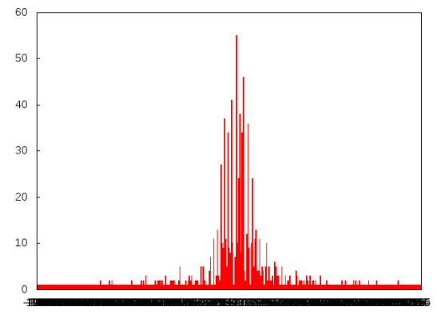
Interpret and quantify the histogram data
Single Compression: Double Compression:
DC:
LP[0]:
Introduction
Implementation
Result

Slide 27
Interpret and quantify the histogram data
Interpret:
  The double compressed images
  show much more drops
  (peaks and valleys)
  We identified this behaviour for most
  of our test images, so we found a way
  to maybe identify double compressed
  pictures using this fact
  Question: How to do it automatically?
Introduction
Implementation
Result

Slide 28
Interpret and quantify the histogram data
Quantification:
  Definition: map human sense observations into numbers
  … in this case it means to map the intense of drops we saw into a number that represents this
  Many ways for quantification, e.g.:
    Count the occurrences of increases / decreases in the wrong direction (deviation count as one)
    Count the values of increases / decreases in the wrong direction (deviation is counted as it’s value)
    Take the maximum deviation
    Use a threshold (only count if the deviation has a minimum height)
    …
Introduction
Implementation
Result

Slide 29
Interpret and quantify the histogram data
12
14
26
7
14
Introduction
Implementation
Result

Slide 30
Interpret and quantify the histogram data
  Afterwards a threshold value has to be found:
    A quantification value beneath the threshold should be recognized as single compressed
    A quantification value over the threshold should be recognized as double compressed
Introduction
Implementation
Result

Slide 31
Introduction
Implementation
Result

Slide 32
…
…
Introduction
Implementation
Result

Slide 33
References
[1] Junfeng He, Zhouchen Lin, Lifeng Wang, and Xiaoou Tang. 2006. Detecting doctored JPEG images via DCT coefficient analysis. In Proceedings of the 9th European conference on Computer Vision - Volume Part III (ECCV'06), Aleš Leonardis, Horst Bischof, and Axel Pinz (Eds.), Vol. Part III. Springer-Verlag, Berlin, Heidelberg, 423-435.
[2] Jing Zhang, Haiying Wang, and Yuting Su. 2008. Detection of Double-Compression in JPEG2000 Images. In Proceedings of the 2008 Second International Symposium on Intelligent Information Technology Application - Volume 01 (IITA '08), Vol. 1. IEEE Computer Society, Washington, DC, USA, 418-421.
Introduction
Implementation
Result

